Slide 1

Presenter
Engage and retain top talent through investing in Learning & Development
Helping managers and leaders connect with and reskill existing employees to meet future capability needs
Chanai Vaznonis
Lead People Scientist
Culture Amp
Notes:
(30 seconds)
Thank you, HCI!
Welcome to Engage and retain top talent through investing in learning and development
This is a session about helping managers and leaders connect with and reskill existing employees to meet future needs.
My name is Chanai Vaznonis, I am a Lead People Scientist at Culture Amp leading a team and supporting our enterprise customers on survey strategy, design, and interpretation. Industrial Organizational Psychology is at the foundation of our work in people science.
My background is in leadership, learning, and organization development across health care, tech, and the various industries of the customers I support.

Slide 2
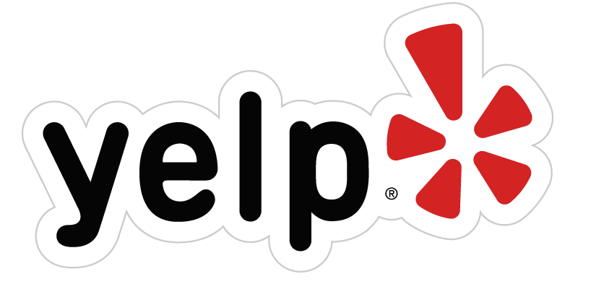

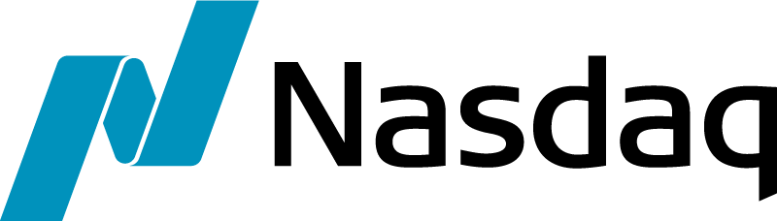
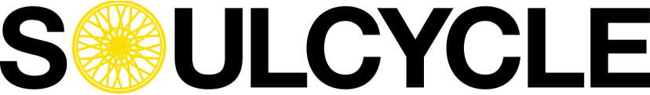
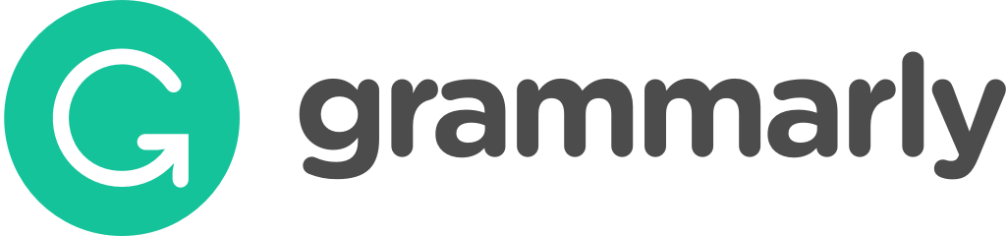
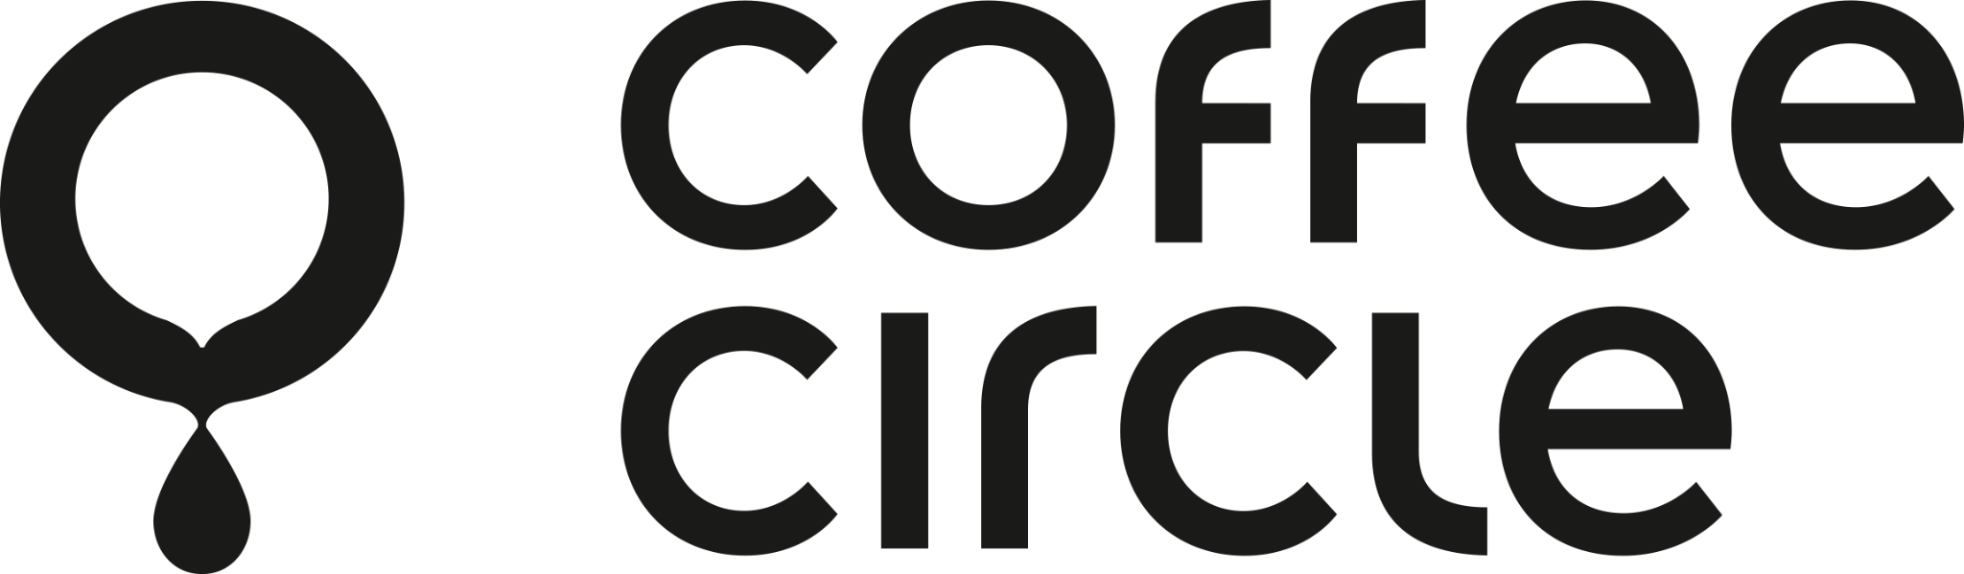
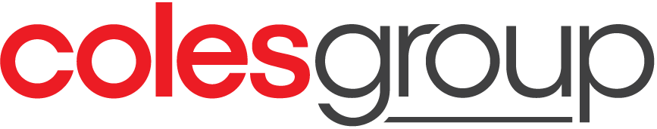
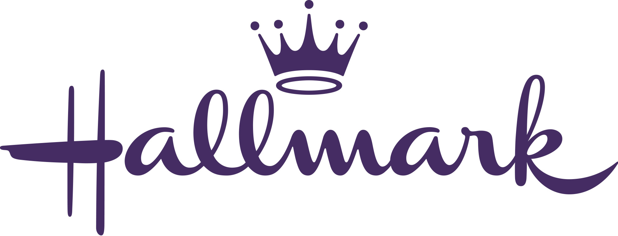
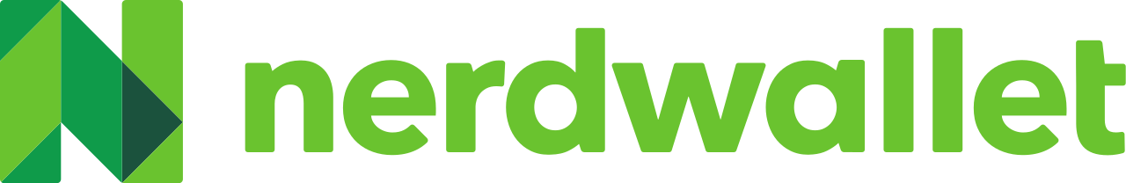
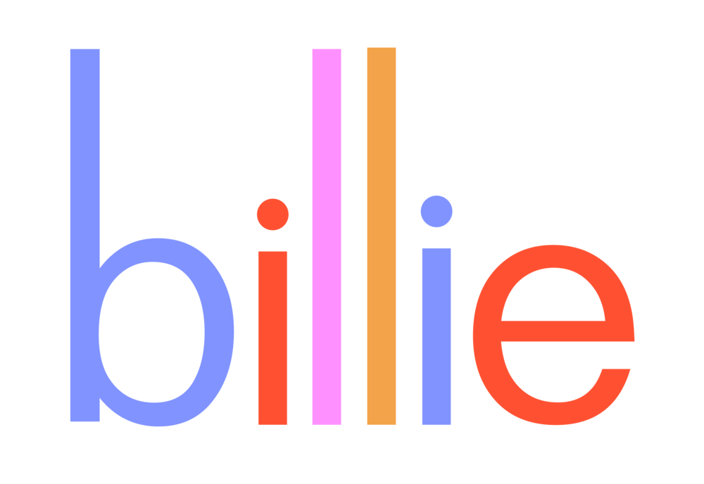
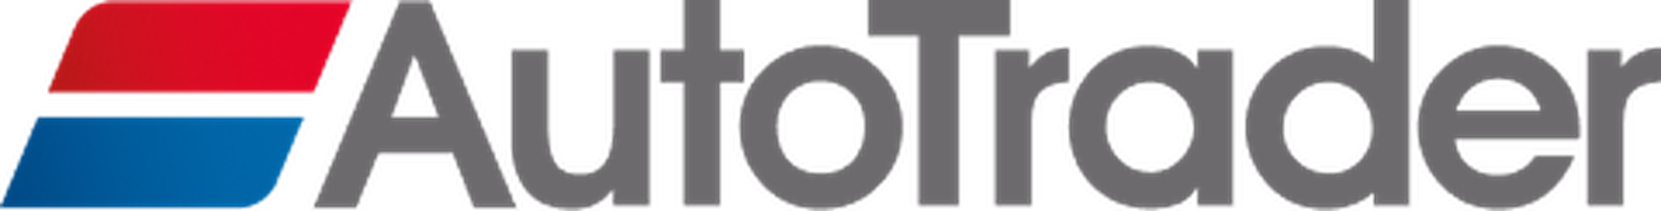

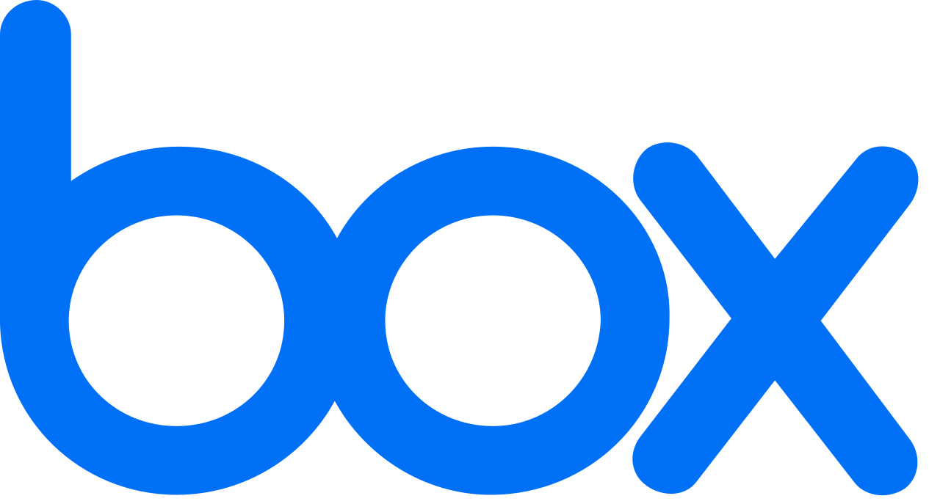
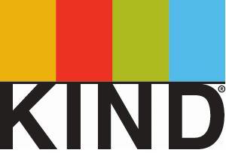
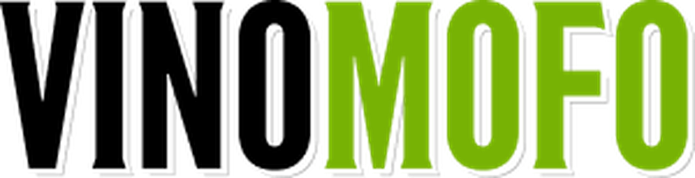
6,000+
Companies
195
Countries
1m+
Reviews completed
8m+
Surveys completed
3k+
Benchmarks
The world's most innovative companies use Culture Amp
38%
Increase in
company confidence
Large Enterprise
Enterprise
Mid Market
SMB
8%
Increase in Revenue
43%
Decrease in turnover
Notes:
(30 seconds)
A little bit about Culture Amp - we’re the leading employee experience platform, we’ve helped over 6,000 of the world’s most innovative and successful companies to create a better world of work.
Some of the names you see here.
We do this by helping companies focus on their employee experience - specifically by improving employee engagement, employee development and employee performance.

Slide 3
Benchmarks
& Predictive Analytics
Science-backed Survey Library
Effective Action Plans
360 Feedback
Growth
Goals
Perform
Accelerate business growth with agile, continuous performance
Engage
Evolve your business by engaging your people
Develop
Grow your people
with personalized, continuous development
Reviews & Calibrations
Individual Development
Plans
OKR/ Goal Tracking
L&D
Insights
1-on-1s
Playbooks
Skills Coach
Powered by People Science
Notes:
(30 seconds)
This is a visual of what our platform offers through perform, engage, and develop.
Today, the most successful leaders have made big impacts toward the issue of employee turnover and their people strategies by moving beyond measuring engagement to a process of continuously creating engagement.

Slide 4
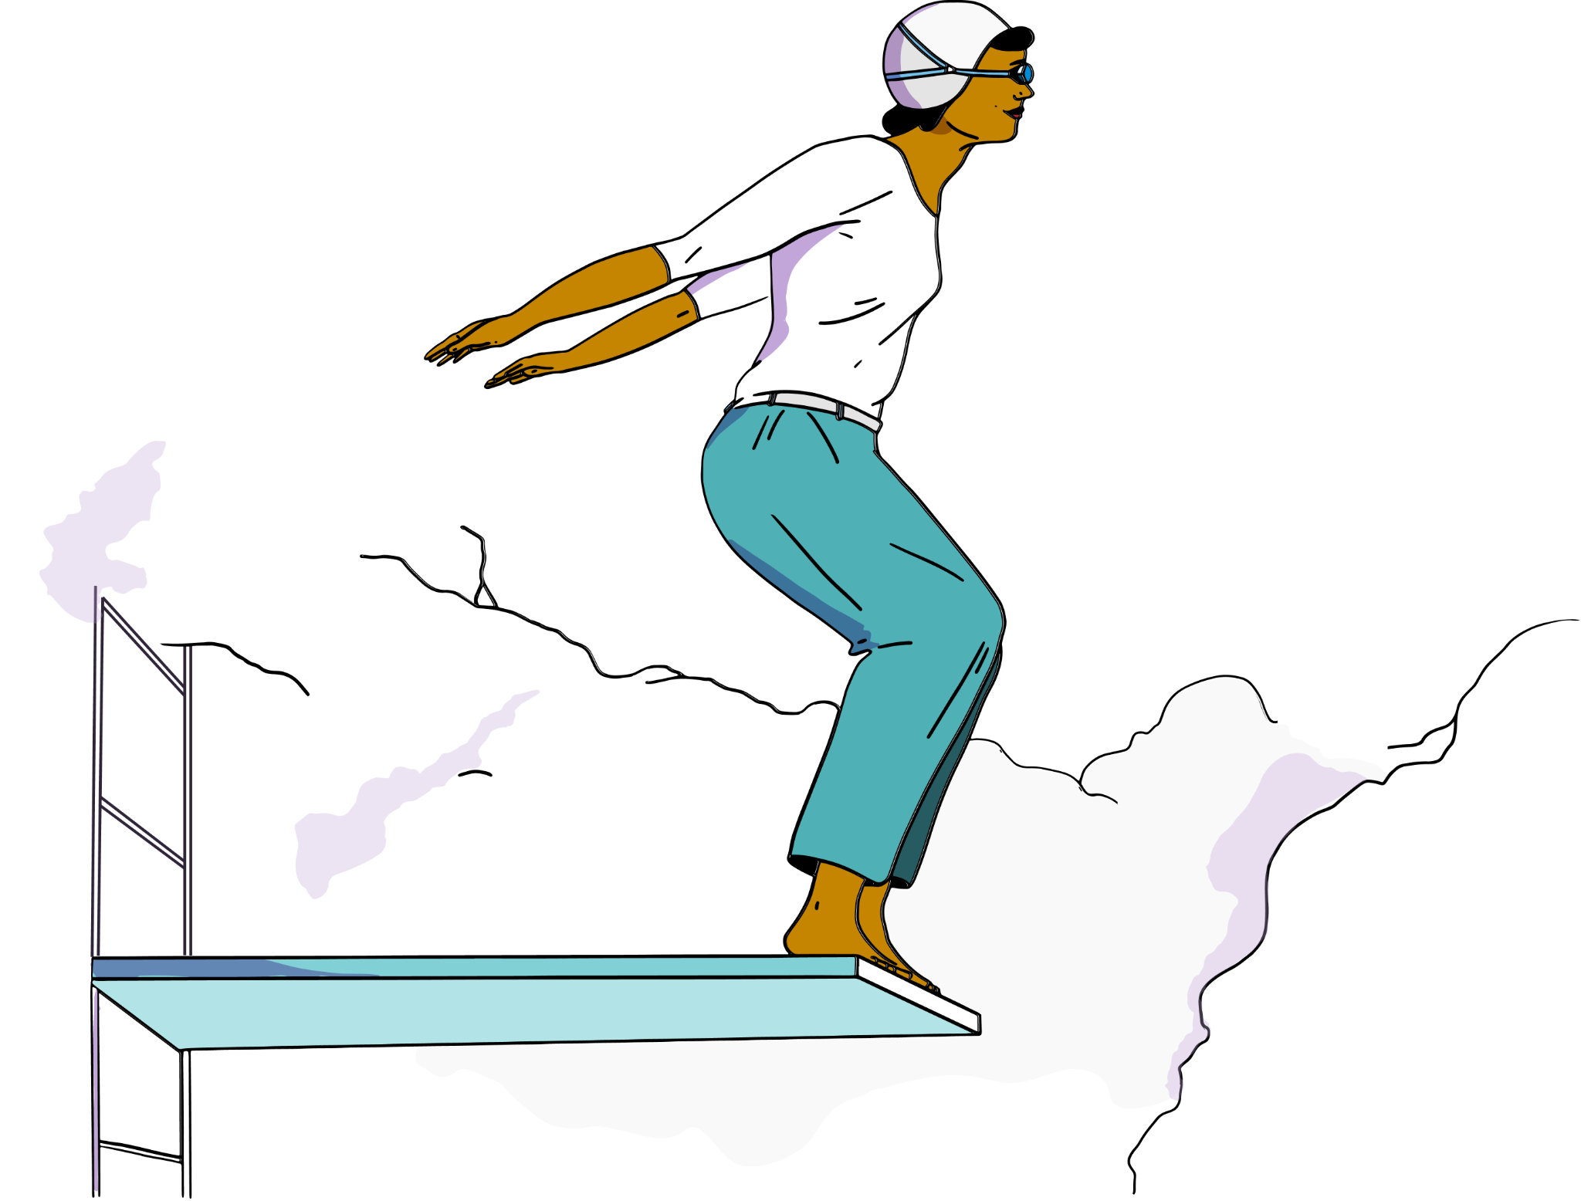
Agenda
Why learning and development should be a priority focus?
The connection between engagement, development, and retention
Aligning your performance management and development approaches to power employee growth
Notes:
(30 seconds)
Our agenda today is
Why learning and development should be a priority focus?
The connection between engagement, development and retention
Aligning your performance management and development approaches to power employee growth

Slide 5
Why learning and development should be a priority focus?
Notes:
(30 seconds)
Why learning and development should be a priority focus?

Slide 6

Notes:
(30 seconds)
We don’t need to tell you that we’re in some uneven terrain here.
The great resignation or reset - people quitting in droves, inflation/recession, quiet quitting, employee and employer power dynamic shifts, and your own internal changes around hybrid/back to office, reorgs, layoffs, and more to continue to meet the demands of the moving market.

Slide 7
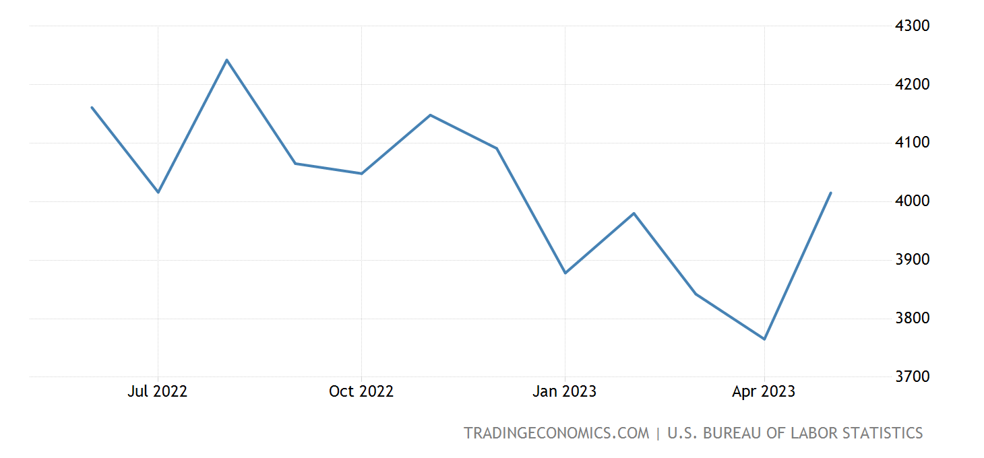
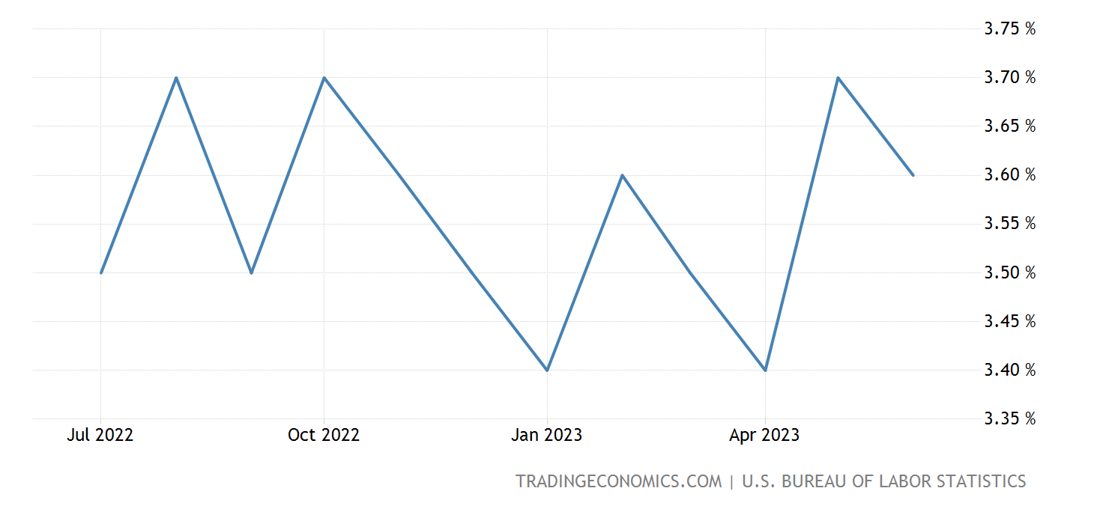
The great reset is continuing
The number of job quits in the US rose by 250K from the previous month
The unemployment rate decreased only by .1% in June from May’s seven-month high of 3.7%
Employed people who quit jobs
Unemployment rate
Notes:
(2 minutes)
And yet the great reset is continuing.
People are still leaving their jobs at very high rates and the trend is continuing.
As you can see there have been some rises and falls, with a more recent trend upward again. The number of job quits in the United States rose by 250K from the previous month to 4.02 million in May of 2023, the highest level since last December. source: U.S. Bureau of Labor Statistics
On the right, is the unemployment rate in the US which has also seen many rises and falls. It decreased slightly to 3.6 percent in June 2023, which is lower than May's seven-month high of 3.7 percent and in line with market expectations. The jobless rate has fluctuated between 3.4 percent and 3.7 percent since March 2022, indicating a consistently tight labor market. source: U.S. Bureau of Labor Statistics

Slide 8
Commitment continues to challenge
Established through solidifying a sense of belonging, growth & development, purpose, and progression
  Affective Commitment
  Emotional Attachment
”I want to stay”
Commitment
Continuance Commitment
  Perceived cost of leaving
Impacted by low unemployment, rising cost of living
”I need to stay”
Normative Commitment
An obligation to remain
When talented people leave around us, normative commitment reduces, leading to turn over contagion
”I ought to stay”
Notes:
(3 minutes)
Commitment also continues to be a challenge. Many of my customers when assessing engagement have opportunities around employee commitment to the organization.
Some people are committed to their jobs because they love what they do, or because their goals align with those of the company. Others might stay because they fear what they could lose if they leave. Still, others might stay because they feel obligated to the company, or to their manager.
What you see here is the Three Component Model of Commitment by John Meyer and Natalie Allen and which was published in the 1991 "Human Resource Management Review." It explains that commitment to an organization is a psychological state, and that it has three distinct components that affect how employees feel about the organization that they work for:
Affective commitment (emotional attachment): “I want to stay” established through solidifying a sense of belonging, growth and development, purpose and progression
Continuance commitment (perceived cost of leaving): “I need to stay” impacted by low unemployment and rising cost of living
Normative commitment (an obligation to remain): “I ought to stay” when talented people leave around us, normative commitment reduces, leading to turn over contagion
We share this model because of its importance around affective commitment as you have more of a lever to pull in growing affective commitment which ultimately helps reduce the team’s reliance on continuance and normative commitment.

Slide 9
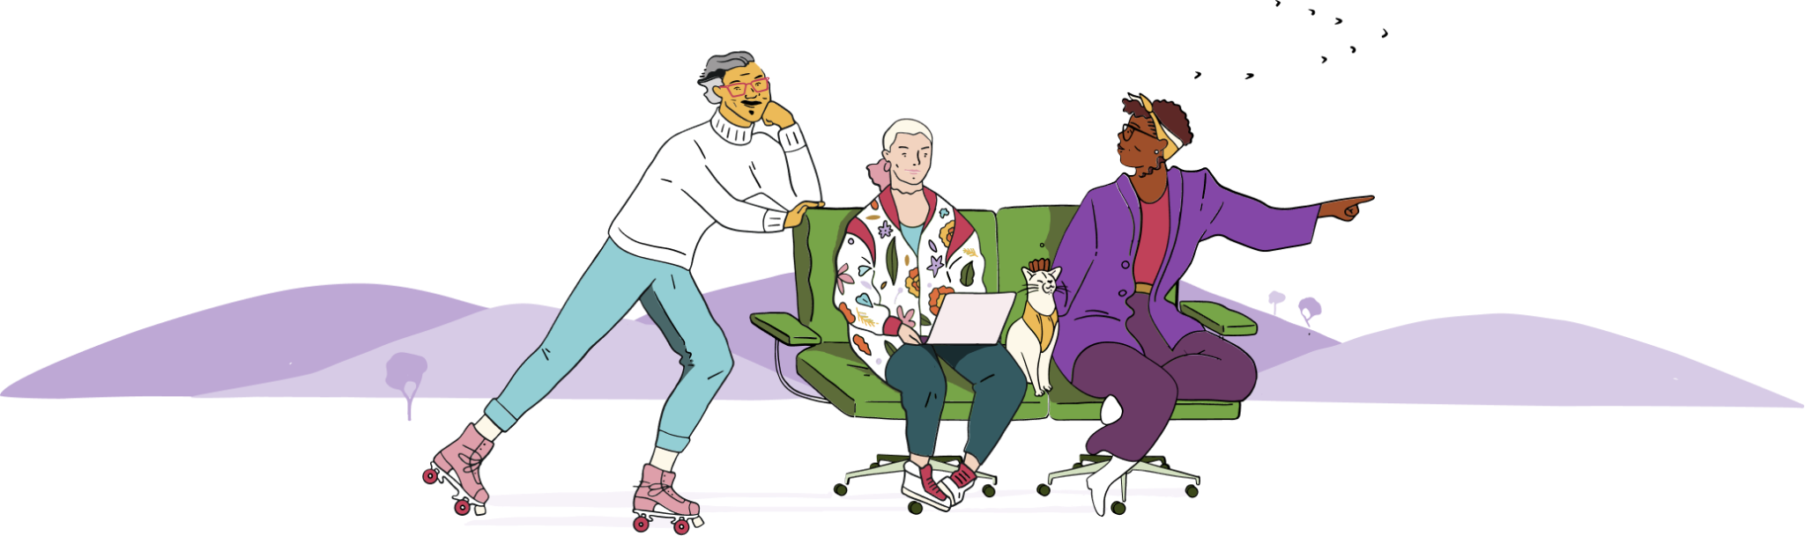
Companies are investing heavily in talent management including personal development plans to foster a supportive environment for talented employees who can easily cope with change
Lejeune et. al 2021
Notes:
(2 minutes)
We have seen more and more companies investing heavily in talent management including personal development plans to foster a supportive environment for talented employees who can easily cope with change.
It is a very interesting time in L&D, and one of the most apparent shifts I have seen is the focus on self-directed learning - due to the rapidly changing nature of the world of work, organizations have been opting for approaches that provide more flexibility that evolve with employees over time, rather than a rigid and tick the box experience.
If you aren’t already investing in learning and development, your competitors likely are. Organizations really need to look at what is most important to their people and empower them to develop the right skills at the right time.

Slide 10
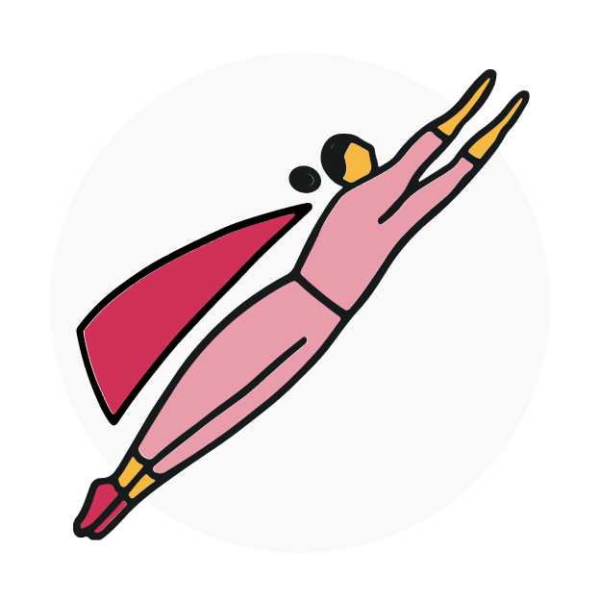
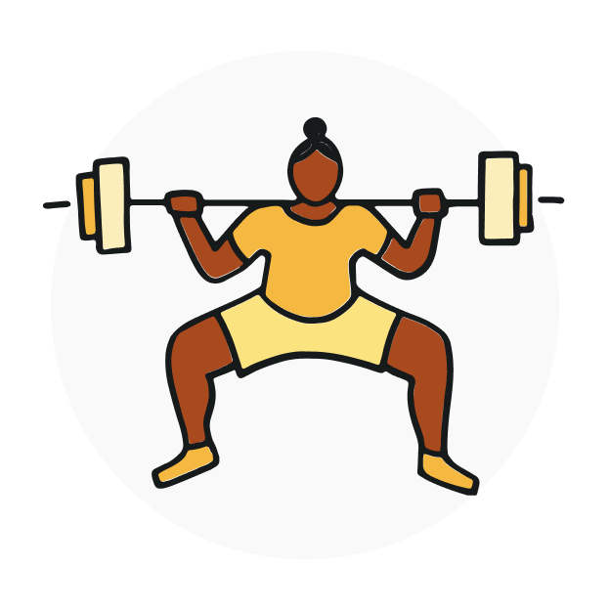

The benefits of development conversations
Employees who report their managers hold development conversations are
40% more motivated
When employees receive useful, consistent feedback, they are 2.1x more likely to go above and beyond
Employees who report their managers hold development conversations are
35-45% more engaged
Source: Engagement and Performance by the Numbers (Culture Amp, 2020)
Notes:
(3 minutes)
And finally, learning and development should be a priority because all of these benefits.
Culture Amp research shows that employees who report to managers who are good coaches are anywhere from 35-45% more engaged and around 40% more motivated to go above and beyond in their role.
Additionally, employees are more than 2 times more likely to be motivated to go above and beyond when they receive useful and consistent feedback.
In the past, the role of a manager was to be a “boss” or a “command and control” style of leader. This style often clashes with the agile, cross-functional, and distributed working arrangements we now find ourselves in, and it’s being replaced by a manager-as-a-coach model, helping to coordinate all of the moving parts teams have to deal with.
To help managers navigate this complex role, leveraging technologies to enable development (and even 1:1) can be a game changer.

Slide 11
The connection between employee development, engagement, and retention
Notes:
(30 seconds)
To further the importance of learning and development, let’s look at the connection between employee development, engagement, and retention

Slide 12
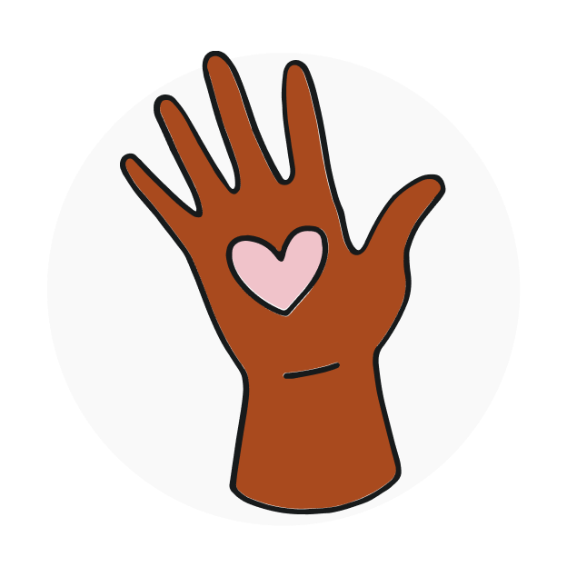
Engagement is…
An employee’s enthusiasm, connection, and commitment to the organization as measured by:
I would recommend [Company] as a great place to work
[Company] motivates me to go beyond what I would in a similar role elsewhere
I am proud to work for [Company]
I rarely think about looking for a job at another company
I see myself still working at [Company] in two years' time
Notes:
(30 seconds)
Let’s start with a definition of engagement; an employee’s enthusiasm, connection, and commitment to the organization which we measure by 5 questions.
I would recommend [Company] as a great place to work
[Company] motivates me to go beyond what I would in a similar role elsewhere
I am proud to work for [Company]
I rarely think about looking for a job at another company
I see myself still working at [Company] in two years' time

Slide 13
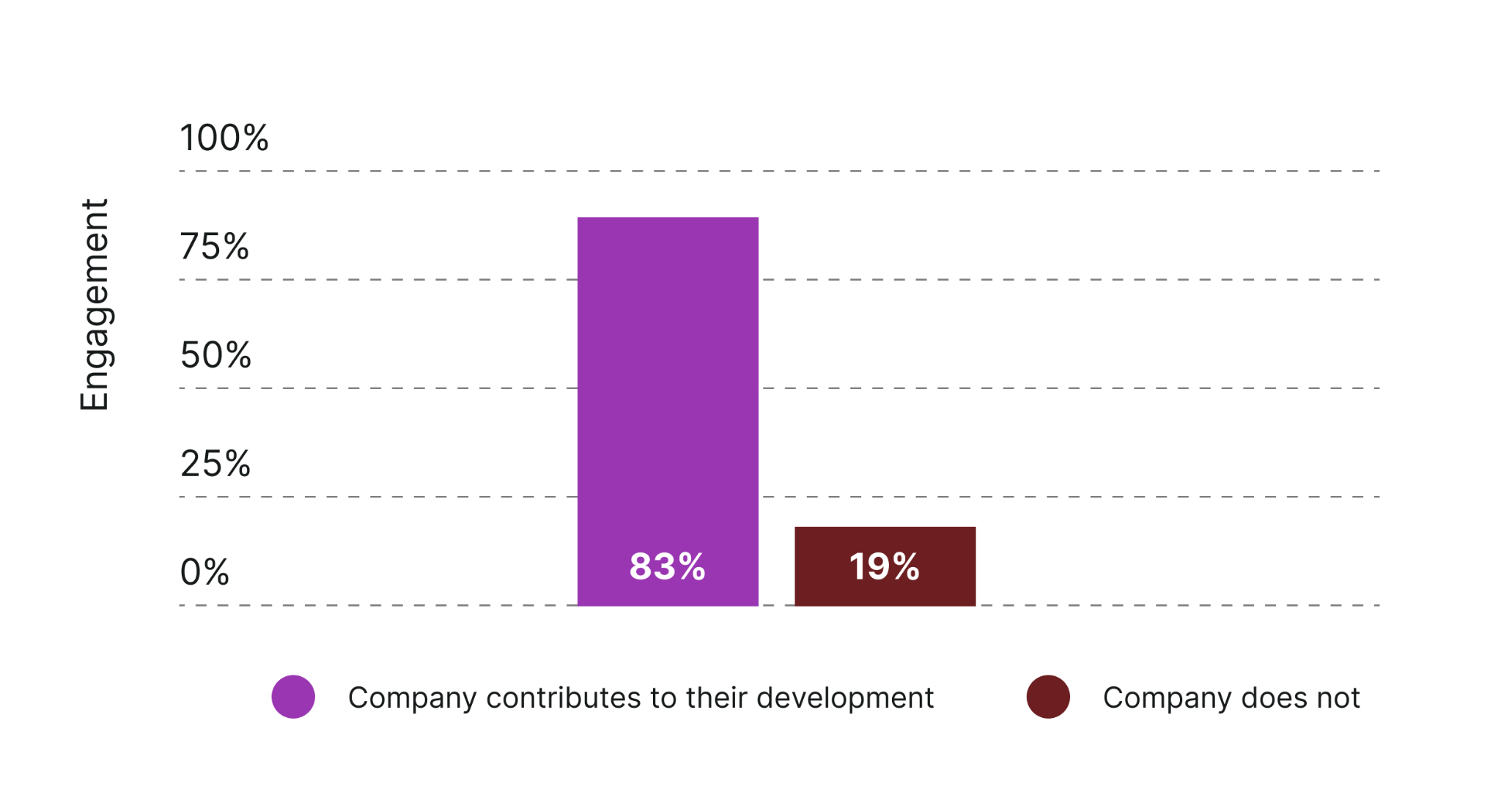
Development is strongly correlated with Engagement
Source: Culture Amp Global Research, 2021
Notes:
(2 minutes)
Development has a bigger impact than you might expect and is strongly correlated with engagement.
If an employee believes that the company is contributing to their development, their engagement is 83%. This is much higher than the global average of 73% [Click]. If all you did was contribute to your employee’s development, you would be 10 points higher than benchmark.
Meanwhile if they disagree, their engagement is a devastating 19%.
In case this data isn’t convincing enough, when we look at our global data lake for the the top drivers of employee engagement (that is the parts of the employee experience most related to driving employee engagement), Development is the second highest driver of employee engagement (just behind the question “I have confidence in the leaders at [Company]”
All of these data points highlight that focusing on development should be a priority for organizations to attract and retain talent.
But what about zooming into commitment specifically. Does development impact retention?

Slide 14

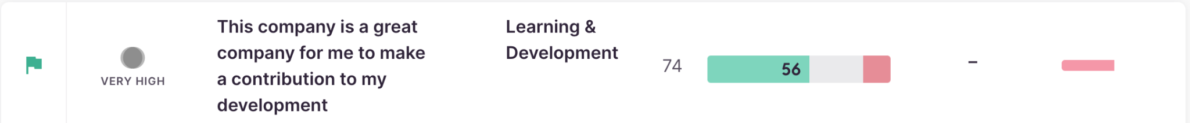
A lack of learning and development opportunities is one of the biggest predictors of low employee engagement and turnover
Notes:
(30 seconds)
A lack of learning and development opportunities is actually one of the biggest predictors of low employee engagement and TURNOVER.
What you see here are two questions we often see as top drivers of engagement:
I have access to the learning and development I need to do my job well
The company is a great company for me to make a contribution to my development

Slide 15
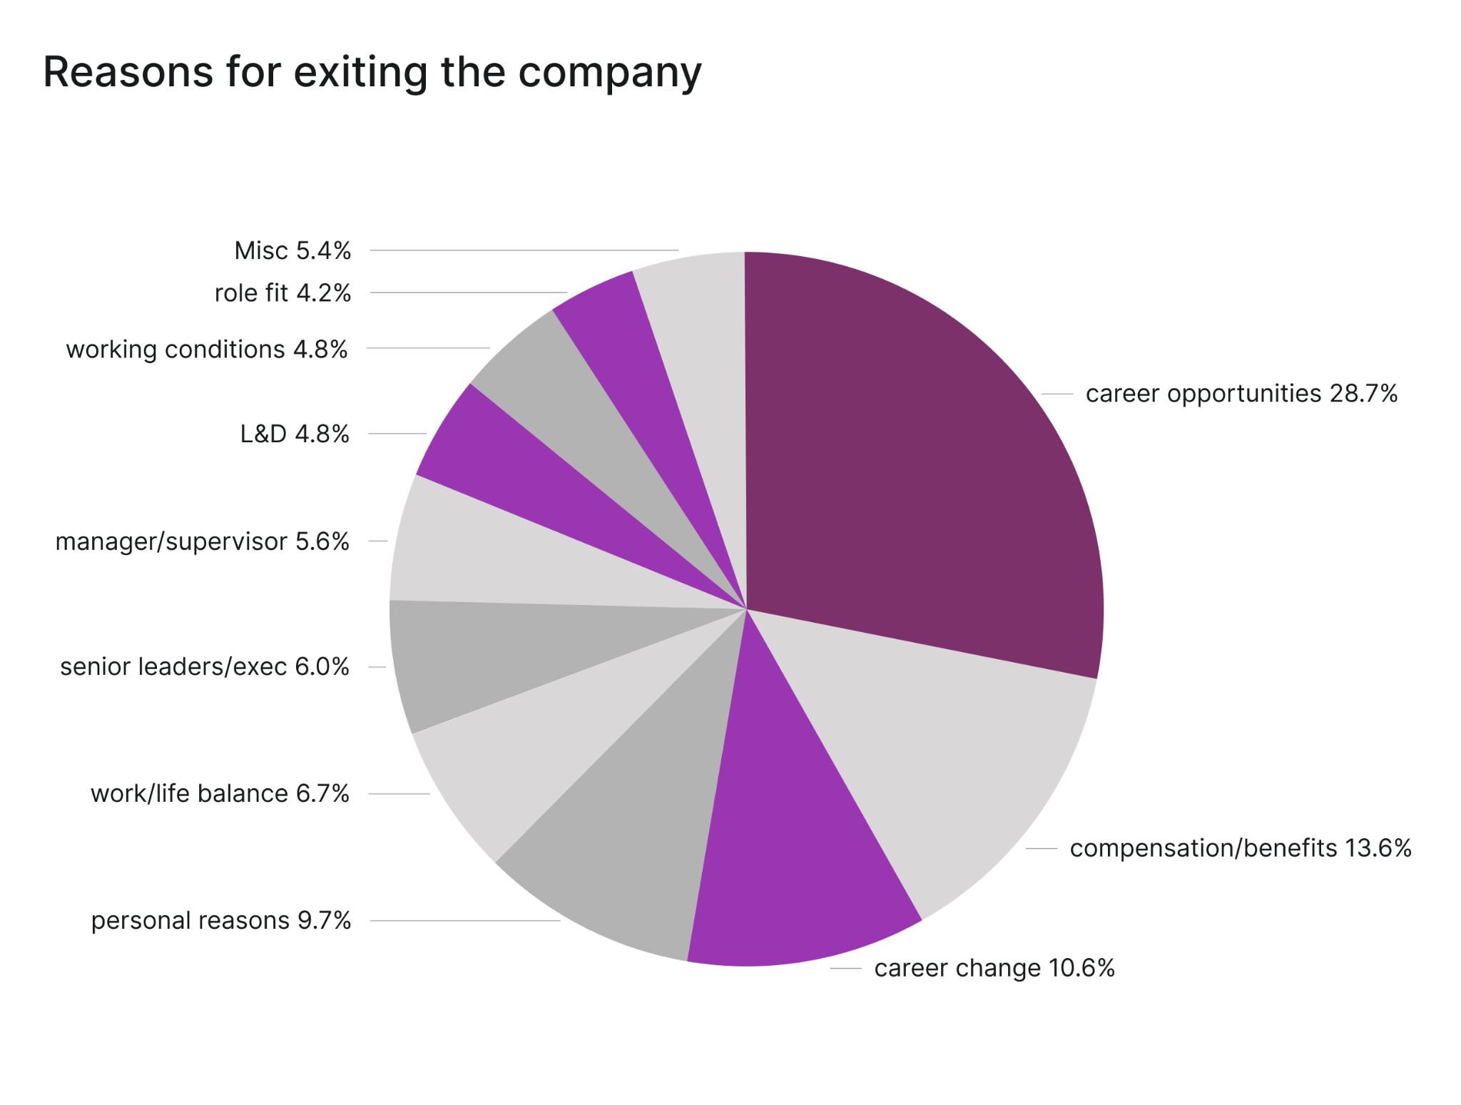
Development is #1 reason cited at the time of exiting
Source: Culture Amp Global Research, 2021
Notes:
(1 minute)
Further, when we looked at the data collected from our exit survey responses from over 100,000 employees over a 12 month, we found that development is the #1 reason cited at the time of exiting.
Development is showing up as more common than compensation, work/life balance and manager combined. In fact, if we add up all reasons that can be solved by having development conversations (that’s Career opportunities, career change, learning and development and role fit) that equals 48% - so we can say essentially half of all employees are leaving because of their experience around development.

Slide 16
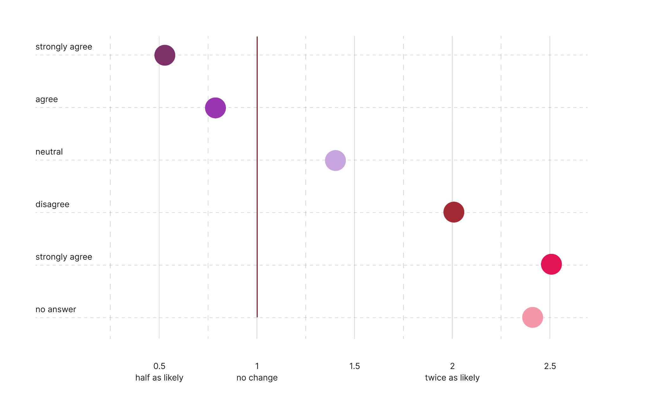
Employees are twice as likely to leave…
Employees are twice as likely to leave if they don’t believe their company is contributing to their development
Notes:
(1 minute)
And lastly, employees are twice as likely to leave if they don’t believe their company is contributing to their development
Employees who disagree with the question “This is a great company for me to make a contribution to my development” are twice as likely to leave within 12 months.
If they strongly disagree, then they are 2.5 times more likely to leave than average
So the message there is clear, there is a strong connection between employee development, engagement, and retention, furthering the reason development is such a priority right now. Focusing on employee development can absolutely help you save money, reduce your turnover costs, and ultimately improve the employee experience.

Slide 17
Aligning your performance management and development approaches to power employee growth
Notes:
(30 seconds)
So what do we do about it?
Let’s consider the role of agile managers and leaders and turn our attention to some of the key principles that help to underpin meaningful growth and development which ultimately helps to align your performance management and development approaches to power employee growth.

Slide 18
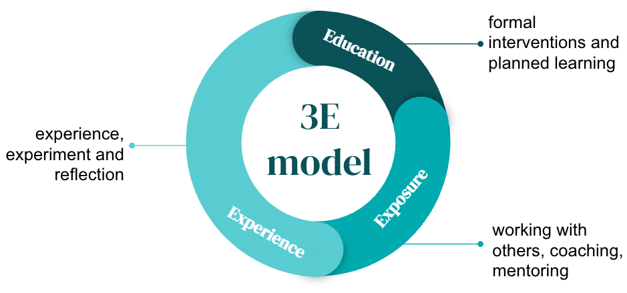
What do we mean by employee development?
The Three E’s model supported by regular coaching conversations and 1-on-1s
Notes:
(2 minutes)
Let’s start with what we really mean when we say employee development?
Let’s consider the potential development activities employees can engage in which can be categorized using the Three E’s model you see here:
Education looks at more formal learning and can include courses, online resources, books and podcasts.
Exposure tends to focus on creating opportunities for things like job shadowing, building cross functional connections to learn more about the work others do, and networking/participating in professional associations or bodies.
And Experience is often where the majority of learning and development happens! This can take many forms, but at its core it’s about finding enriching development activities in the day to day tasks of the role. Stretch projects, accompanied by reflection and leader-led coaching, is one of the more effective forms of development that comes from experience based learning.
Across all of these types of development, there needs to be support in place like regular coaching, 1 on 1s, training to support employees on progress, aligning to goals and importantly to receive recognition for the efforts and achievements or even redirection.
Importantly, employee development is too often thought of as just engaging in development activities, but true employee development also takes into account things like promotions, job crafting, and lateral career movements.

Slide 19
Aligning objectives
Business
need
Meaningful growth occurs at the intersect between an employee's aspirations, their unrealized or realized strengths, and true business requirements or needs.
Slow
progress
Company wins short term
Sweet
spot
Aspirations / motivations
Skills / strengths
Employee wins short term
Notes:
(1 minute)
Meaningful growth occurs at the intersection between an employee's aspirations, their unrealized or realized strengths, and true business requirements or needs.
The consequences of having two out of three aspects aligned tend to lead to poorer outcomes. For example, without a business need, employees develop in the short term, but their development doesn’t provide additional value to the business.
The role of the leader is to align these three objectives and make sure the development plan created by your people take all these objectives into account.

Slide 20


Ash’s current development experience
Succeeding in current role and eager to advance
What is the next step?
How do I get to the next step?
a) Speaks to manager but no formal goals created
b) Has an idea of goals, but they’re not shared
c) Doesn’t know where to start at all
Withdrawal behaviors
Frustrated by sense of stagnation in career and lack of support for advancement
Notes:
(2 minutes)
Let’s look at an example.
Ash is doing well in their current role and is eager to start advancing and learning about new opportunities. They start wondering…. (Click) What is the next step…. (Click) How do I get there….
With not much direction, Ash decides to have a conversation with their manager about what could potentially be next. The conversation seems to go well, Ash thinks maybe there could be something and sets a broad goal to develop- but doesn’t know how to share this in a meaningful way or what success will look like at the end.
(Click)The conversation gets put on the back burner, forgotten and never spoken about again. (Click) Ash feels frustrated about the lack of progress, stuck without direction and starts quietly quitting.
Does this sound familiar? It is easy to get caught up in other activities and de-prioritize development.
Ultimately development is a shared responsibility that should be driven by the employee and supported by the organization. However, this typically isn’t a skill that we walk into the workforce with- how do I grow, develop, learn for what is next- how do I know what is next.
Having a manager or leader focused on regular connection about development and technology can help better facilitate this experience with individual employees.

Slide 21
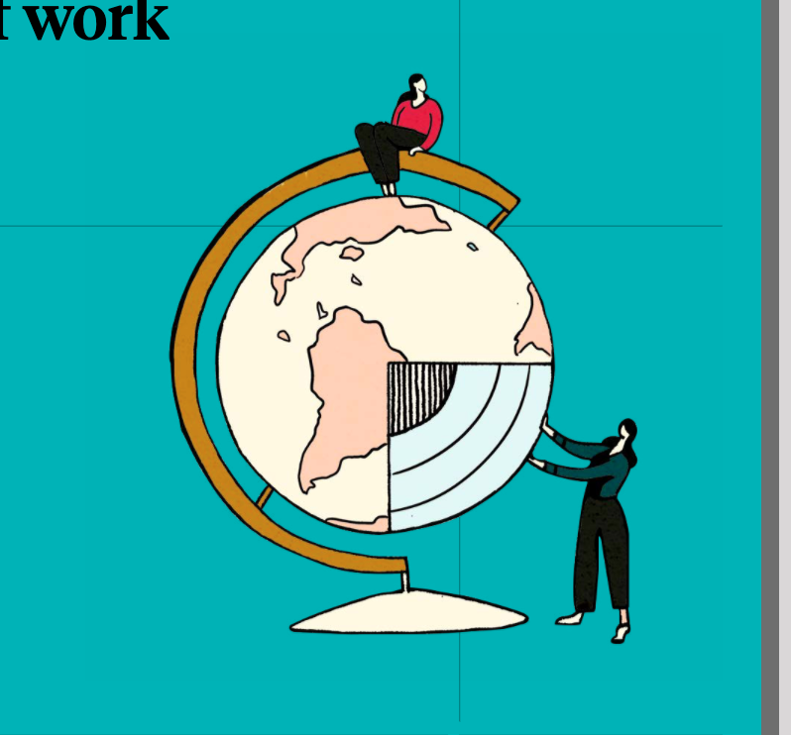
Sam’s current development experience
Succeeding in current role and eager to advance
Manager leans into development conversation, exploring next steps
Sam seeks feedback and completes self-reflection cycle to understand motivations/aspirations
a) Speaks to manager shape action goals
b) Leverages technology to input goals and tracks over time
Citizenshipbehaviors
Clear pathway identified for career and support for advancement
Notes:
(3 minutes)
Let’s try another example.
Sam has been working in their role for a little while and doing well, eager for challenges and what might be next. (click) Embedded in the annual development cycle, Sam’s manager starts a conversation- “we are heading into the development cycle and there are a few potential pathways that you might like to consider, the different pathways would require different skills and opportunities to develop- Have you thought about what is next for you”.
After discussing the potential pathways (and what they might look like, including some of the pitfalls), (click) Sam’s manager launches a develop cycle, with Sam collecting feedback from peers, direct reports, and their manager, Sam then completes a self-reflection journey to help identify their motivators, strengths, opportunities areas and aspirations. This helps Sam create tangible goals that are shared and reviewed with their manager. (click) Sam now how as clear pathway identified and knows how they are going to get there.
Now this is an extreme example from the previous, however a way to think about the role of a manager or leader. It can be as simple as initiating a conversation about what they believe is next, how they think about their development, and what support and regular touchpoint are they seeking. It is completely fine for an individual to say they don’t need extra support right now as development can ebb and flow. Asking them how they want to approach in the future allows them to lead and for you to support.

Slide 22
From development to career progression
Development
Career
Progression
Demonstrate proficiency & growth
Can their current role grow / level?
(Is there enough work to justify)
Gain skills & experience
Results or outcomes
Ready (and willing) for a promotion?
Is there a company need?
(budget or headcount)
Values / behaviors
Is there an available role?
Notes:
(2 minutes)
Another great way to conceptualize what development really means, is to compare the limited perspective of what development looks like vs. what true employee development actually is.
Traditional perspectives, what you see on the left, see development as gaining skills and experience in order to:
help employees demonstrate skill proficiency and their ability to grow
help them meet their performance goals and deliver results, or
help them build needed behaviours or demonstrate values
All of this is true, but it’s not where true development ends. When development is disconnected from things like career opportunities, performance; employees can struggle to understand the tangible impact of developing in the organization.
Capability and skill Development should ideally have a tangible longer term outcome, which comes in the form of potential promotion opportunities and career progression like you see on the right. When looking at readiness to promote, these three criteria (proficiency, results and values or behaviors) would all be evaluated
First, we look to whether a promotion aligns to the employee’s aspirations. While they may appear to be a good fit for a promotion, it might not align with their own career aspirations. Or potentially, it might be appealing to them but not be the best time, due to personal life circumstances.
Once readiness is assessed, the business need should to be taken into consideration. An individual may be ready, but there may not be a suitable opportunity for them.
Is there is enough work available to allow the employee to be grown in their current role? For example a stage or level change within the role.
Is there a company need for the promotion or level change? Is there budget or headcount available to support the change?
Is there an available role open? Is there competition for that role?
Employees want to know where their development ultimately will lead, even if they are pulling in a sense of their own self-interest and often times that is where performance and development align to power employee growth!

Slide 23
Everyone plays a role
Provides the structure, systems, processes, and resources
Coaching and supporting team members to grow and develop
Company
Sets the tone culturally
Removing barriers preventing development
Leaders
Connecting employees to opportunities
      Ownership of plan and accountability to ‘drive’ their own development
Help team members build a plan
and take action
Team Members
Sets and tracks goals and actions
Notes:
(2 minutes)
And when it comes to development, everyone plays a role. A successful development process involves clear roles and responsibilities for all involved, and relies on each participant taking ownership and accountability for their part of the process. The organization, leaders, and employees all have a unique role to play when it comes to supporting development.
First, the role of the organization or company is to provide the structure and resources needed to support development and growth. This can come in different forms, such as access to learning content, processes and technology to support development conversations, and guidance in relation to performance and promotion or role mobility processes. The organization also plays a critical role in creating a culture that reinforces the importance of learning.
The role of the employee is to take ownership over their development. This means being accountable for setting goals, taking action to develop, and actively seeking out development opportunities.
Lastly is the role of the leader,
The first responsibility of leaders in supporting development is to act as a coach for employees. This means helping them to clarify their development goals, working with them to consider the various options that might help them to develop, and providing timely and relevant feedback aligned to their development.
The second responsibility of leaders is to clear barriers that might prevent employees from being able to truly engage in growth and development, or from another angle, enabling employees by actively identifying development opportunities and potential career mobility opportunities, such as promotions or lateral career movement.

Slide 24
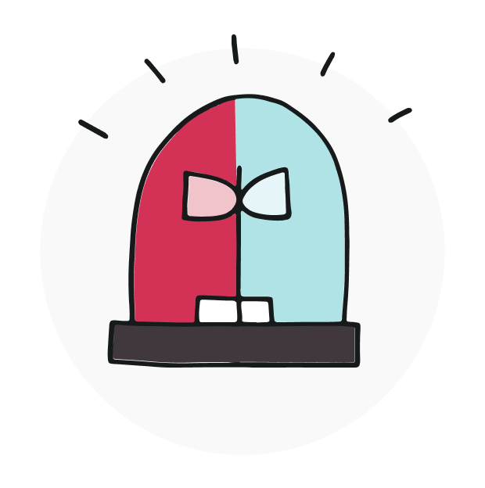
Key development principles
Individual employees own and drive their own development, but appropriately supported by managers, leaders, and the organization Employee development is balanced, personalized and dynamic, supported and guided, and provides actionable feedback and reflection Senior leaders play a key role in championing and empowering the success of employee development Performance and development conversations should be a separate but aligned process Technology helps to empower employees to embrace self-directed learning
Notes:
(3 minutes)
So as we start wrapping up the conversation
Some of the Dos to remember for employee development are:
Firstly clarity in the roles and responsibilities is essential, but employees should drive their own development and feel appropriately supported by manager, leaders, and the company.
Employee development is balanced – considering the needs of the business and the individual, , personalized and dynamic to what they define as development and how they want to grow, supported and guided as mentioned in the first point, and provides actionable feedback and reflection for continued growth
The success of any intervention or initiative lies in the role of senior leaders and leaders- remember to ensure your leaders are on board and SHARE their own experience of learning and development
When it comes to performance, development should be aligned. Ensure that you create separate conversations to encourage managers/employees focus on the PAST and FUTURE separately- ensuring they are still informing each other.
And the final key success factor relates to leveraging technologies to help employees (AND MANAGERS SUPPORT) to embrace a self-directed approach to learning and development in the workplace such as a 1:1 platform, an employee development tool.
Remember that there is no one way, but it is essential that you measure your progress and success- leveraging the power of data to continuously improve your approach.
If you do anything, start the conversations with your employees; learn about what development means to them, discover ways to support, offer guidance and coaching. Wherever you are with this process, start with them.

Slide 25
Thank you
Notes:
(1 minute)
Thank you for your time today! See you in the colleague cafe.

